Slide 1




NEXT GEN EMPLOYABILITY PROGRAM
Creating a future-ready workforce
Team Members
College Name
Student Name: Bershy.P
Student ID : au960221104043
Arunachala College Of Engineering For Women

Slide 2

CAPSTONE PROJECT SHOWCASE
Project Title
Car Rentals Application with Django Framework
Abstract | Problem Statement | Project Overview | Proposed Solution | Technology Used | Modelling & Results | Conclusion

Slide 3
Abstract: The design and development of a feature-rich car rental application that aims to improve user experience in the context of contemporary mobility is presented in this project. Advanced features like a strong reservation management system, secure payment processing, real-time vehicle availability, and an intuitive interface are all included into the program. The program makes use of cutting-edge technologies, such as GPS monitoring and machine learning algorithms, to guarantee effective fleet management and resource allocation. Additionally, a focus on user convenience is made through tailored suggestions, an easy-to-use booking system, and attentive customer service. The suggested application provides a scalable response to the expanding needs of the vehicle rental sector, enabling consumers all over the world to travel smoothly and hassle-free.
Source :

Slide 4
Problem Statement:
The problem statement for a car rentals application may include "Designing and to create a simple to use mobile devices application that enables users to easily search, evaluate, and book rental cars from multiple providers, while providing characteristics such as secure payment options, real-time accessibility, and successful consumer support."
Source :

Slide 5
Project Overview:
The goal of the auto rental application is to give consumers an easy way to rent cars for all kinds of needs. User registration, car selection, booking administration, payment processing, and user reviews are some of the important features. To improve client happiness and retention, the app will provide a wide selection of automobiles, flexible booking choices, and a seamless user experience. The application will also have strong security features to protect user information and transactions.
Source :

Slide 6
Proposed Solution:
Features like easy-to-use booking interfaces, personalised vehicle selection, real-time availability tracking, safe payment processing, easy communication between users and rental companies, and GPS integration for navigation might all be found in a comprehensive auto rental application. User experience and happiness can also be improved by adding features like customer service channels, loyalty programmes, and user reviews.
.
Source :

Slide 7
There are various elements involved in developing a Next Gen Employability programme for a car rental application:
Development of Skills: Determine the essential competencies needed for positions in the organisation, such as sales, customer service, vehicle repair, and administration.
Training Modules: Create training materials that emphasise these abilities, covering both theoretical understanding and real-world application.
Software Collaboration: Include instruction on how to efficiently use the vehicle monitoring, booking management, and customer communication elements of the rental car application.
Soft Skills:Training in soft skills, which are necessary for success in any role and include teamwork, communication, problem-solving, and adaptability, should be included.
Source :

Slide 8
Mentorship Programme: Assist new hires during their training phase by matching them with seasoned staff members.
Evaluation and Review: Conduct regular evaluations to monitor advancement and provide personnel helpful criticism, enabling them to keep improving.
Growth of professional Paths: Provide staff with defined development goals and avenues for professional advancement within the organisation.
Continuous Learning: Support a culture of lifelong learning and skill improvement by providing regular training sessions, workshops, and internet resources.
By putting these elements into practice, the forthcoming Generation Employment programme may better prepare staff members for success in the automobile rental application, increasing their employability and boosting the success of the business as a whole.
Source :

Slide 9


Technology Used
Front-end
Back-end
Source :

Slide 10
Modelling And Result:
Cutting-edge technologies like AI-driven vehicle tracking systems, predictive maintenance algorithms, and customer experience improvements might be the core emphasis of a Next Gen Employability programme for car rentals. Employees would get training on how to use these technologies efficiently, as well as problem-solving techniques and a customer-centric approach. Improved customer happiness, decreased downtime, increased operational efficiency, and a trained workforce equipped to adjust to emerging market trends are possible outcomes.
Source :

Slide 11
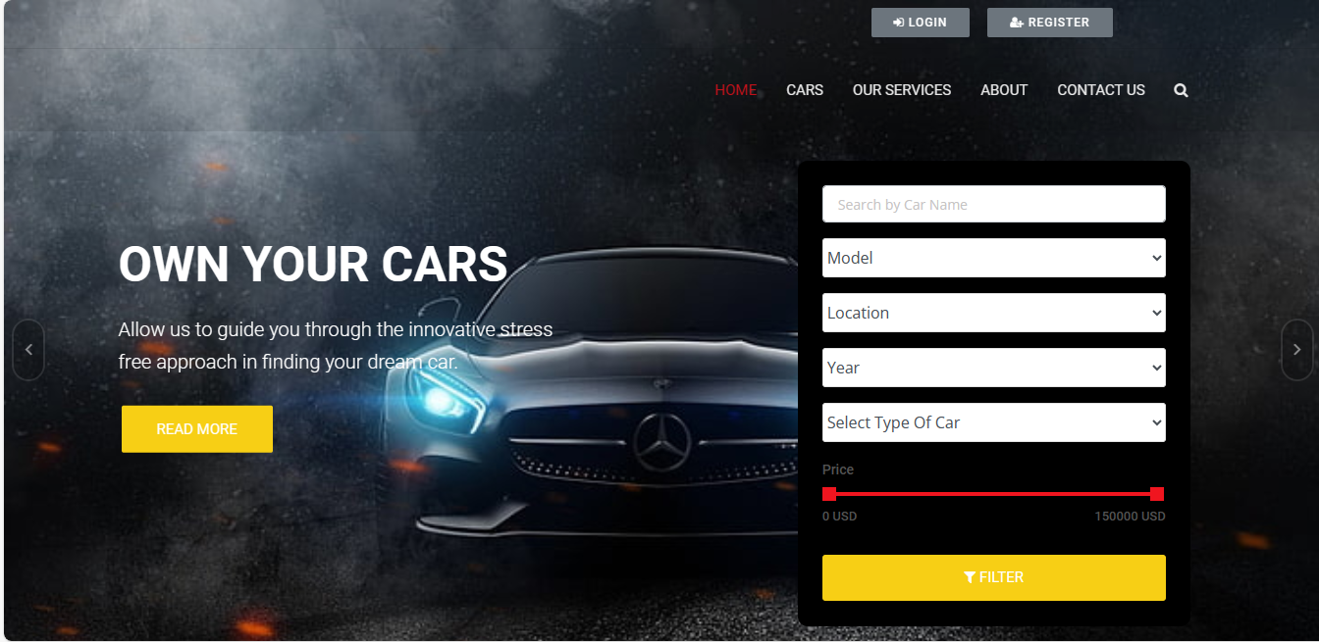
Homepage

Slide 12
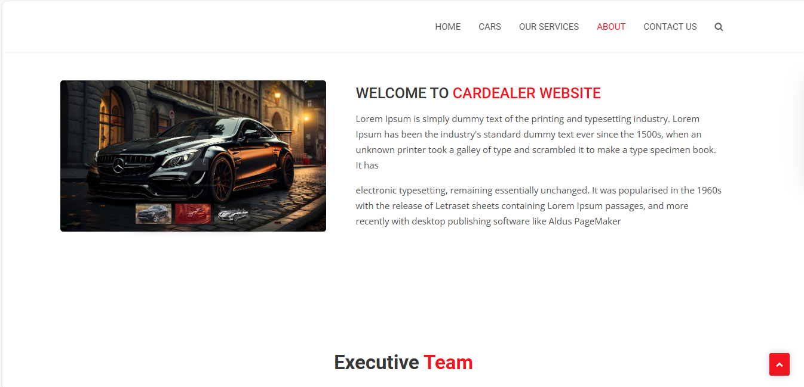
About-Us-Page

Slide 13
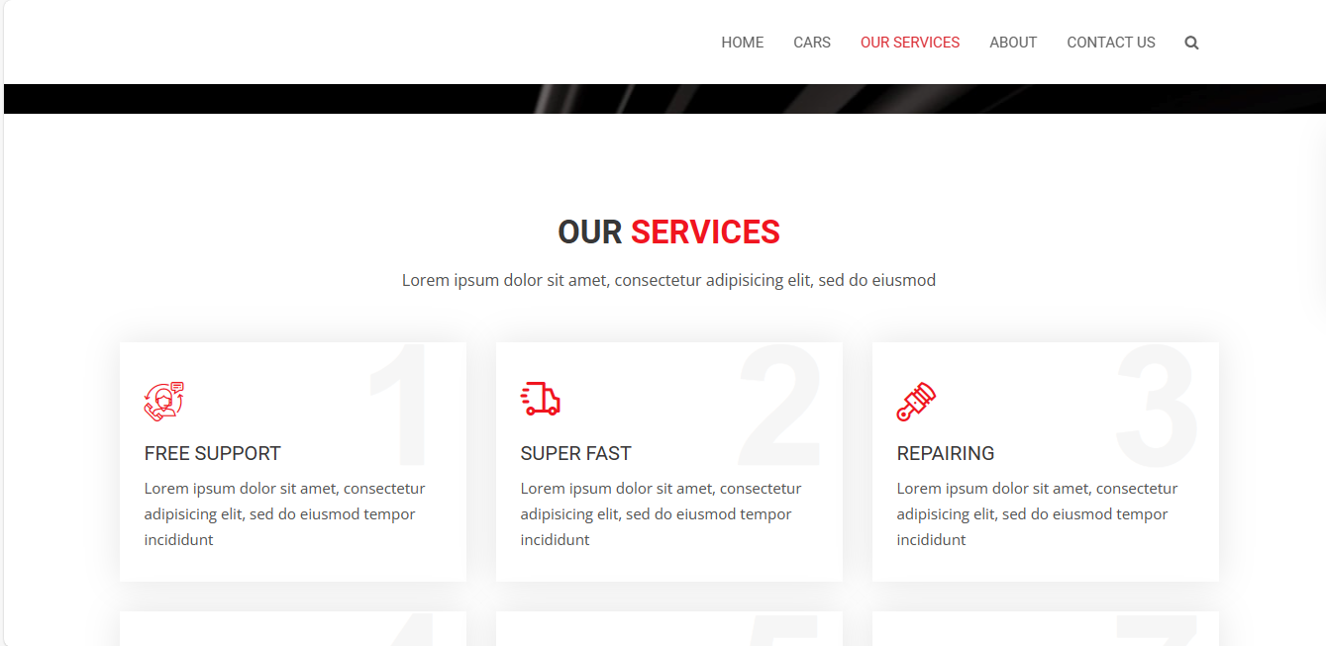
Service-Page

Slide 14
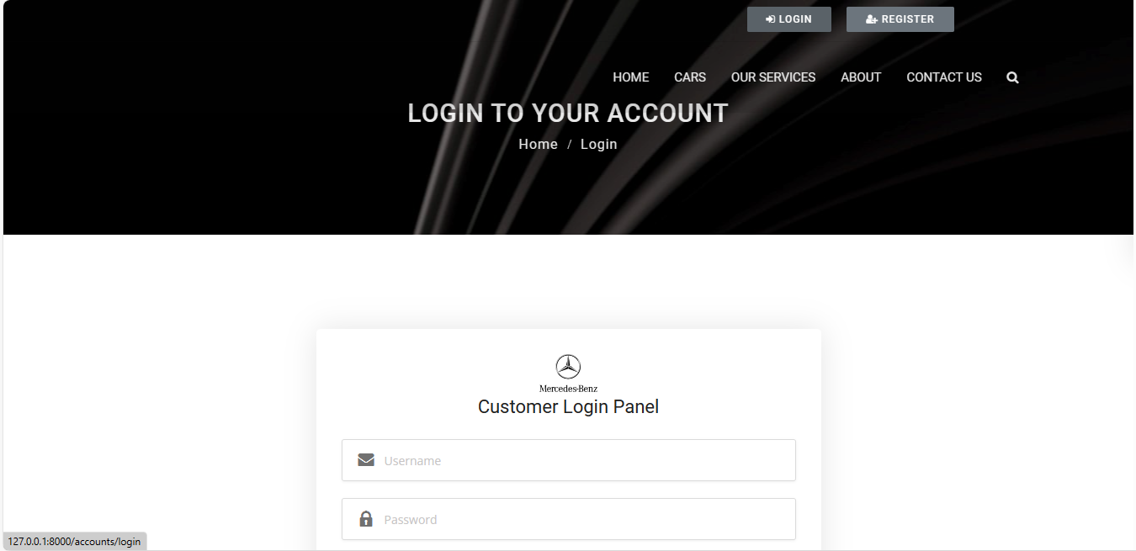
Login Page

Slide 15
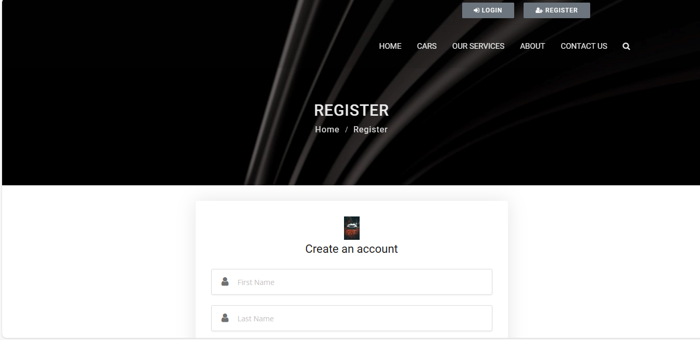
Register Page

Slide 16
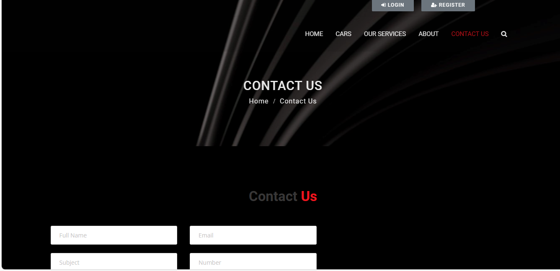
Contact page

Slide 17
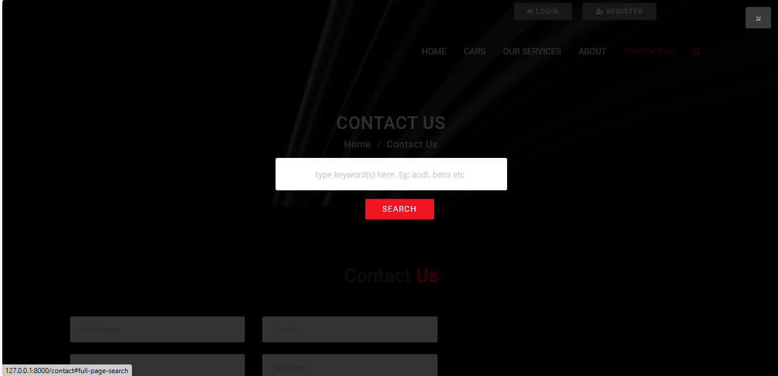
Search page

Slide 18
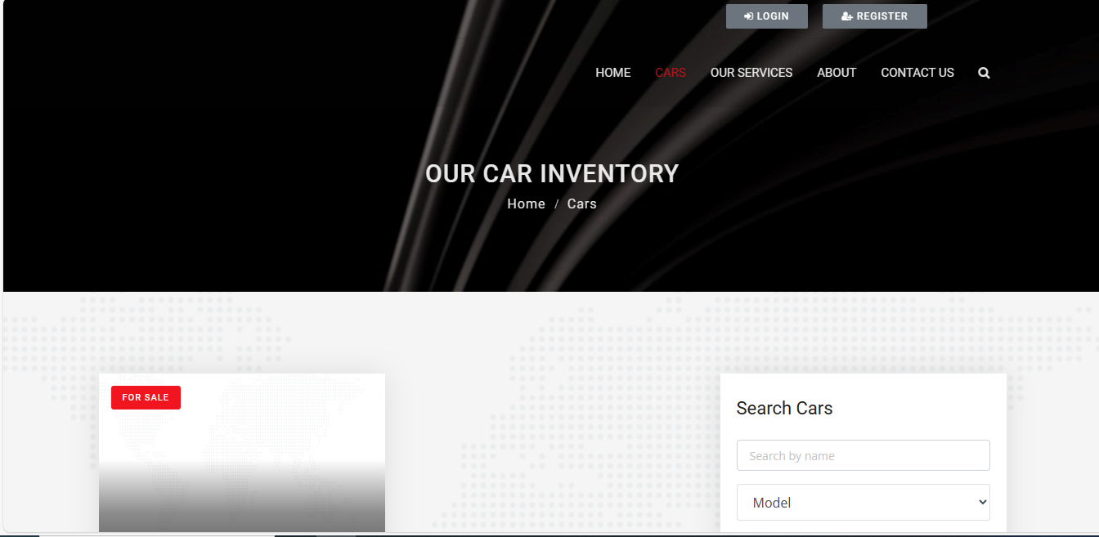
Our Car Inventory

Slide 19
Final Enhancement:
Adding a function that lets users book and pay for auto maintenance services straight from the app is one possible upgrade for a car rental app in the future. To make it easier for customers to maintain the condition of their rental automobiles, this might include alternatives for routine maintenance like tyre rotations, oil changes, and inspections.

Slide 20
Conclusion:
In summary, a car rental app gives users choice, flexibility, and convenience. Both car owners and renters can benefit from the application's user-friendly design, large selection of automobiles, clear pricing, and effective booking and support services, which can improve both parties' overall experience. To further ensure client pleasure and loyalty, the rental process can be further streamlined by incorporating features like digital contracts, GPS navigation, and car tracking. Investing in technology-driven automobile rental platforms offers a significant opportunity for growth and innovation in the transportation industry, given the growing need for mobility solutions.
Source :

Slide 21
Thank You!
Notes:
Thank You !!

